Slide 1









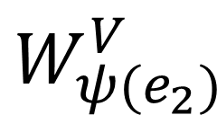

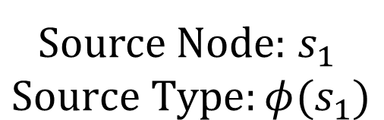


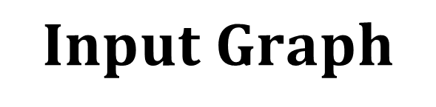
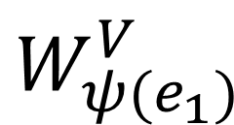


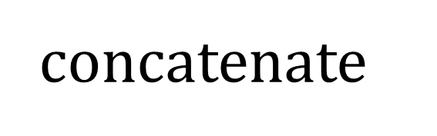







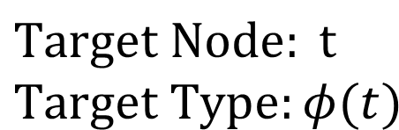
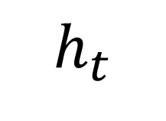

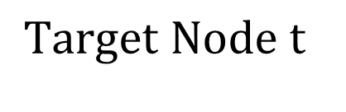


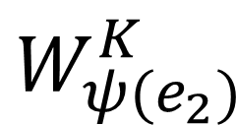




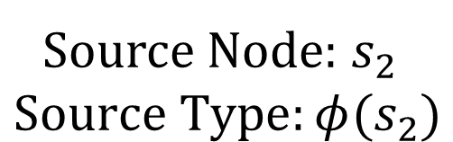
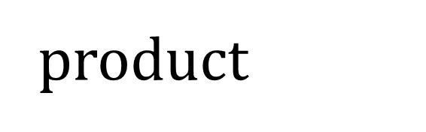

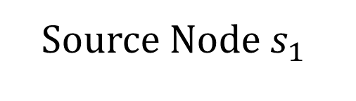







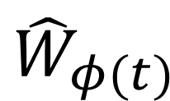
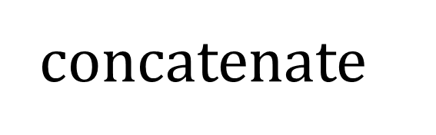

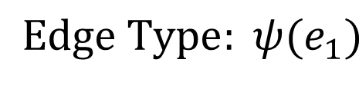
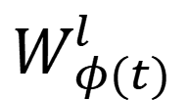


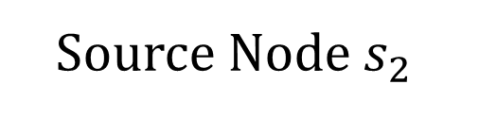
TRLA Layers
Topology-Robust Local Attention
2-hop
Source Node$s_{1}$
$$Input Graph$$
Source Node: $s_{1}$
$$Source Type:φ(s_{1})$$
$$W_{ψ(e_{1})}^{V}$$
$$x_{s_{1}}$$
$$W_{φ(s_{1})}$$
$$W_{ψ(e_{1})}^{K}$$
$$α_{s_{1}t}$$
$$h_{s_{1}}$$
1-hop
$$Target Node t$$
$$Edge Type: ψ(e_{1})$$
$$W_{ψ(e_{1})}^{Q}$$
$$W_{ψ(e_{1})}$$
$$Edge \\ Scaled \\ Sigmoid$$
$$Target Node: t$$
$$Target Type:φ(t)$$
$$h_{t}$$
$$x_{t}$$
$$W_{φ(t)}$$
$$Σ$$
$$W_{φ(t)}^{l}$$
$$h_{t}$$
$$W_{ψ(e_{2})}^{Q}$$
$$W_{ψ(e_{2})}$$
$$Edge Type:ψ(e_{2})$$
$$x_{s_{2}}$$
$$W_{φ(s_{2})}$$
$$W_{ψ(e_{2})}^{K}$$
$$α_{s_{2}t}$$
concatenate
$$h_{s_{2}}$$
Source Node: $s_{2}$
$$Source Type:φ(s_{2})$$
$$W_{ψ(e_{2})}^{V}$$
product
Downstream Tasks
Source Node$s_{2}$
$$W_{φ(t)}^{f}$$
$$z_{t}$$
Multi-Relation Global
Cross-Attention
molecule - target
$${\hat{W}}_{φ(s_{1})}$$
Feed Forward Network
Source
Self-Attention
$$X_{φ(s_{1})}$$
Multi-Head Self-Attention
herb - target
$${\hat{W}}_{φ(s_{2})}$$
$${\hat{H}}_{s}$$
Multi-Relation
Cross-Attention
Feed Forward Network
Multi-Relation
Cross-Attention
herb - molecule
$$X_{φ(s_{2})}$$
$${\hat{h}}_{t}$$
Multi-Head Self-Attention
$${\hat{H}}_{t}$$
$${\hat{W}}_{φ(t)}$$
target - disease
$$X_{φ(t)}$$
$${\hat{H}}_{t}$$
Feed Forward Network
Meta-Relations
concatenate
Target
Self-Attention

